Slide 1
Uncrossable lesion in heavy calcified RCA CTO retrograde PCI
Grzegorz Sobieszek MD, PhD
Assocc. Prof.

Slide 2
Potential conflict of interest
Proctoring:
Boston Scientific
Biotronic
Abott
Procardia
Speakers Honorarium:
Terumo
Biotronic
Boston Scientific
Brosmed

Slide 3
Clinical Presentation
Case 1
CTO RCA
Echocardiography:
  EF 30%
78 y. o. male;
Medical history:
  CAD CCS III (Post STEMI ant. and previous PCI LAD 2004)
    4 unsuccesful attempts of RCA CTO PCI, patient qualified coronary sinus reductor
  HFrEF
  Hyperlipidemia
  Creatinine 1,1mg/dl eGFR >60
JB430511

Slide 4
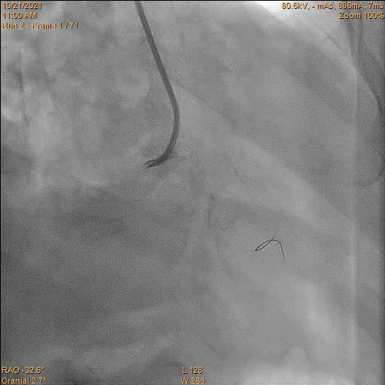
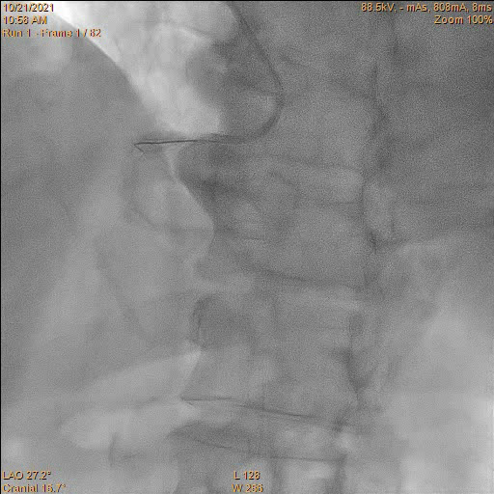
Angiography

Slide 5
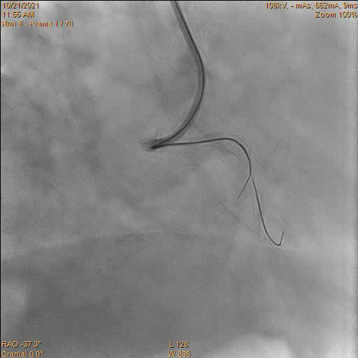
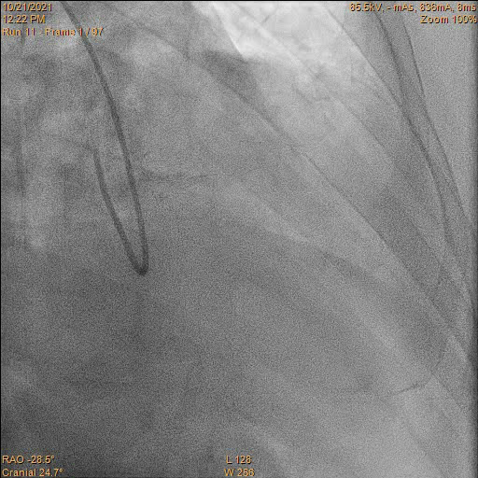
Angiography

Slide 6
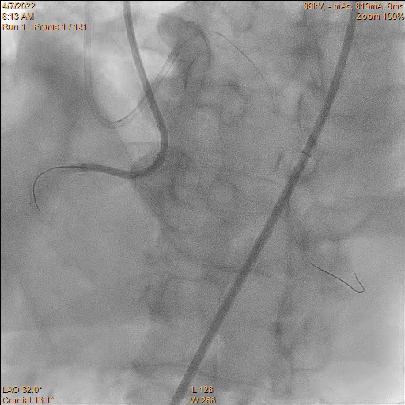
Angio

Slide 7
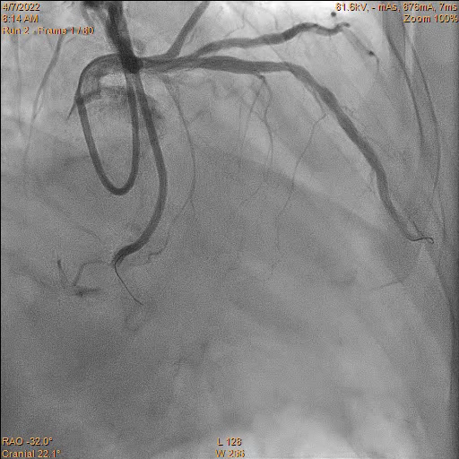
Retrograde collaterals

Slide 8
J-CTO SCORING SYSTEMS (probability of procedural success ) |  |  |  | PROGRES CTO score (likelihood of technical success )
previously failed attempt | 1point | 0 pkt easy |  | proximal cap ambiguity |  | 1 point |  | 0 point 98,2%
 |  | <2 pkt intermediate |  | Absencje of „interventional” colaterals |  | 1 point |  | 1 point 97,2%
blunt proximal cap | 1point |  |  | Moderate/severe tortuosity |  | 1 point
bending >45° in the CTO segment | 1point | 3 pkt difficult |  |  |  |  |  | 2 points 91,6%
calcification | 1point |  |  | CX CTO |  | 1 point
length of the occluded segment is >20 mm | 1point | ≥3 pkt very difficult |  |  |  |  |  | ≥ 3 points 76,7%
Total points: 4 |  |  |  | Total points: 1
EuroCTO (CASTLE) score (probabilities of failure of PCI) |  |  |  | PROGRES CTO (Risc of complications)
CABG previous | 1 point | 0-1 point probabilities of failure 8% |  | age > 65y.o | 3 points |  | 0-2 points Risc of complications 0,2%
age ≥70 | 1 point
severe tortuosity | 1 point | 2-3 points probabilities of failure 8-35% |  | length of the occluded ≥ 23mm | 2 points |  | 3-4 points Risc of complications 2%
Bunt or none cap | 1point
length of the occluded ≥ 20mm | 1point |  |  | Retrograde approach | 1 point
calcification | 1 point | ≥ 4 points probabilities of failure ≥35% |  |  |  |  | >4 points Risc of complications 6,6%
Total points: 3 |  |  |  | Total points: 3

Slide 9
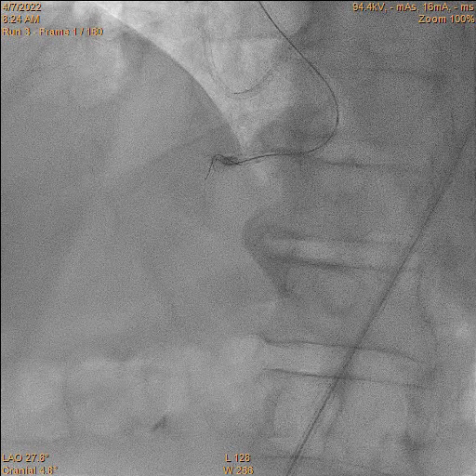
Antegrade dissection and re-entry (ADR)
BASE technique

Slide 10
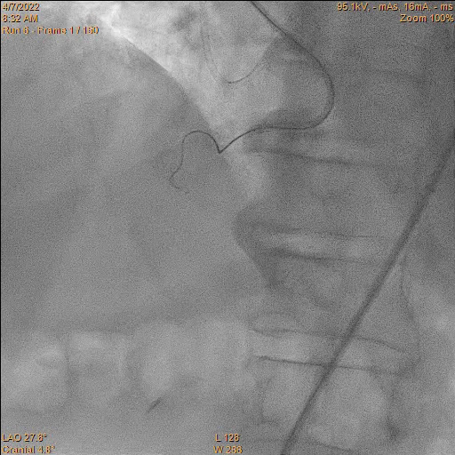
Antegrade dissection and re-entry (ADR)
Knucle side branch

Slide 11
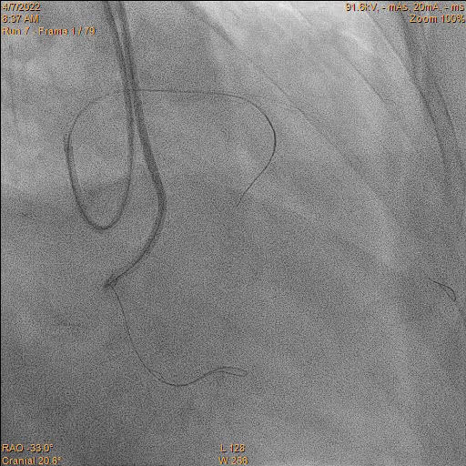
Retrograde

Slide 12
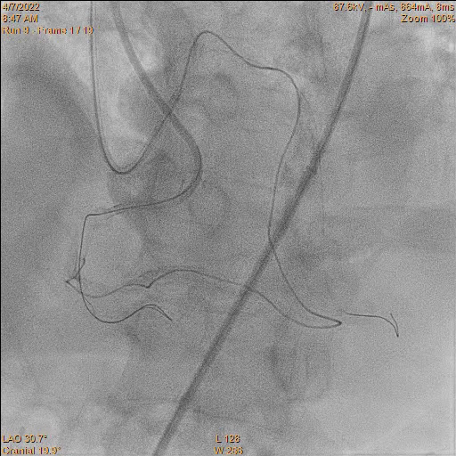
Retrograde
Tip injecton

Slide 13
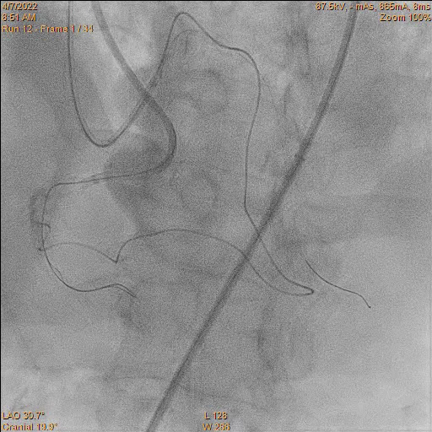
Retrograde
Stop retrograde wire
Carlino technique

Slide 14
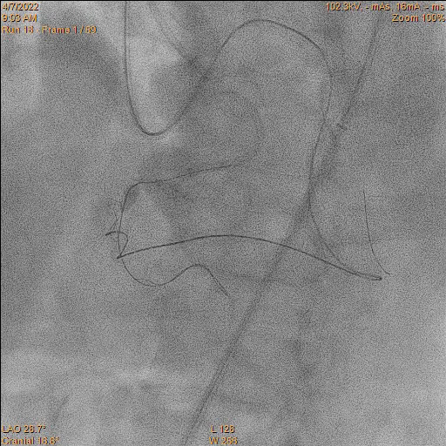
Retrograde
1st revers CART

Slide 15
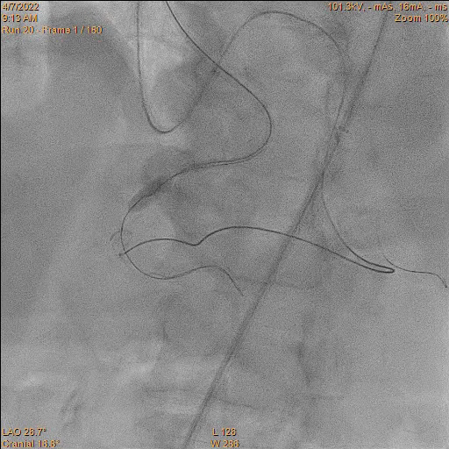
Next BASE technique

Slide 16
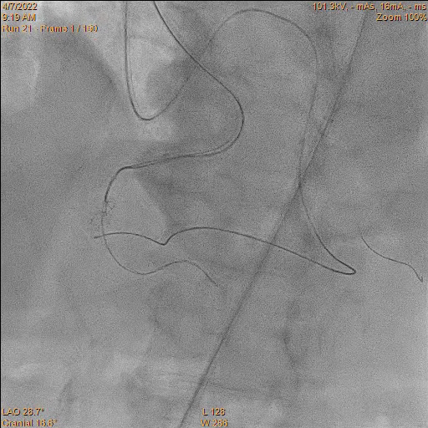
Next Knucle side branch

Slide 17
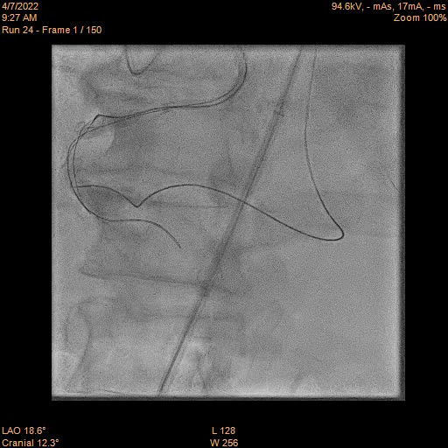
Next BASE technique

Slide 18
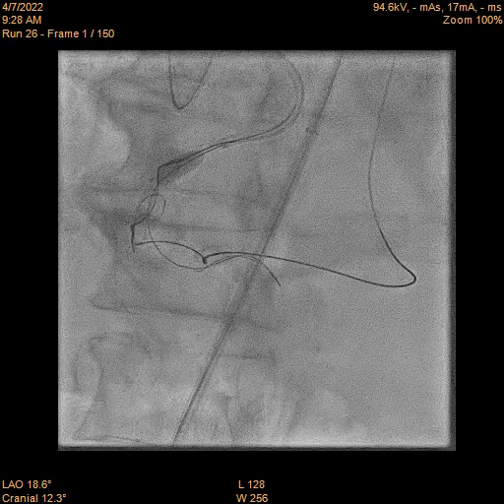
Power knucle RCA

Slide 19
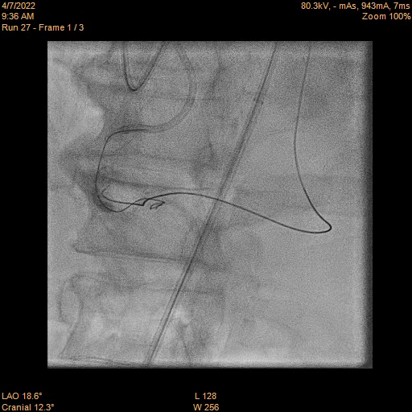
Next revers CART

Slide 20
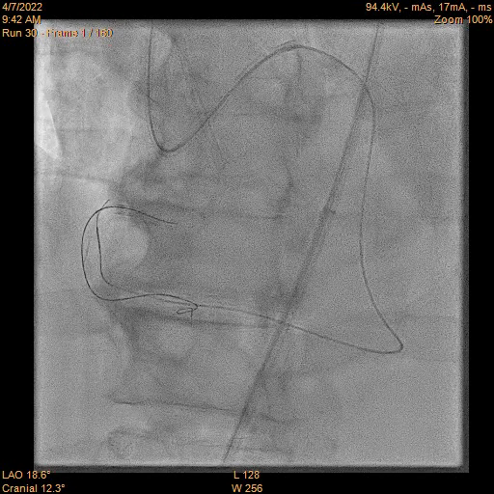
Retrograde
Retrograde wire progress to aorta

Slide 21
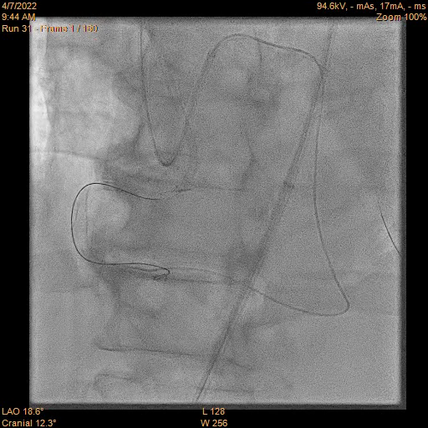
Retrograde
MC in aorta
wire exchange to RG3

Slide 22
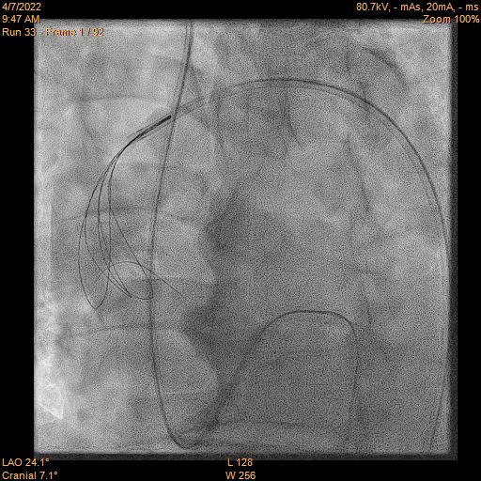
Retrograde
Snare

Slide 23
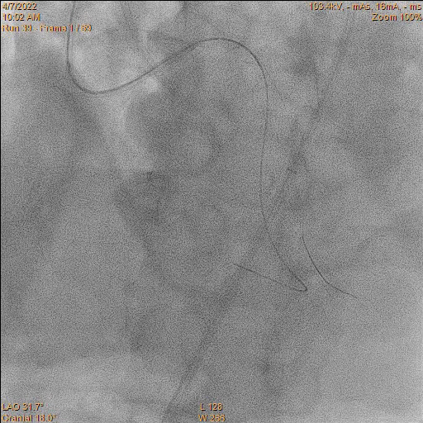
Externalization
Predylatation >
uncrossable lesion >
SC 0,75/10mm balloon

Slide 24
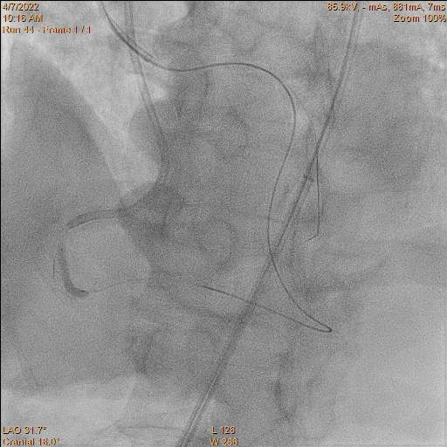
Predylatation
S.C. 2,0/15mm
S.C. 3,0/15mm
NC 3,5/20mm

Slide 25
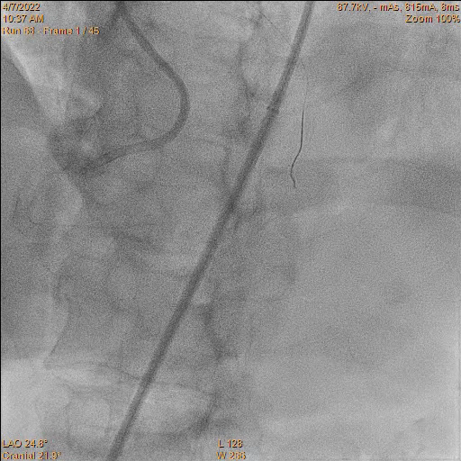
The final result
DES 4,0/44mm
DES 4,5/33mm
www.masterctopoland.pl

Slide 26
Conclusions
Massive calcification can be challenge in CTO procedur
Trust the knuckle wire
  possible problems:
  forming the knuckle wire,
  redirection knucle wire
Uncrossable Lesion
  S.C. 0,75 mm balloon is very valuable options in uncrossable lesion
Next option can be:
  Anchor, guide extension
  rotablation or orbital aterectomy
  Granadoplasty
  MC
  External crush
  Possible use of external lithotrypsy

Slide 27
Thank you for your attention!

